Slide 1
Academic contribution between Dr HDR. Pierre CHABAL & Prof. Dildora KHODJAEVA 2021/22-2023/24

Slide 2
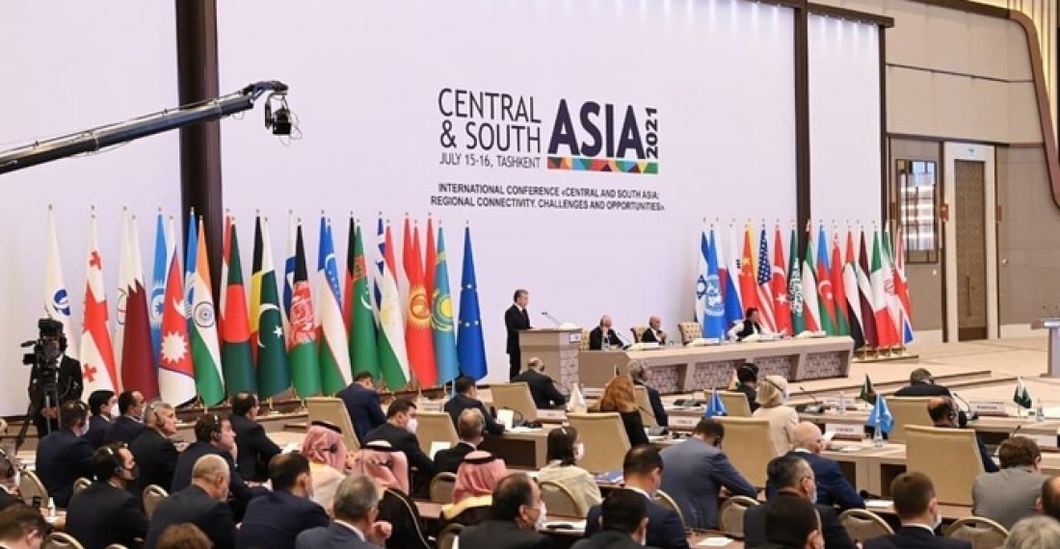
15-16 July 2021 Conference organized upon the initiative of the President of Uzbekistan, Tashkent: “Central and South Asia Regional Interconnectedness. Challenges and Opportunities”

Slide 3
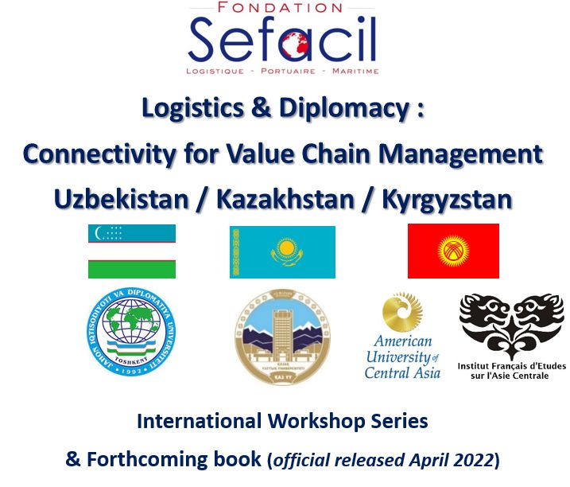
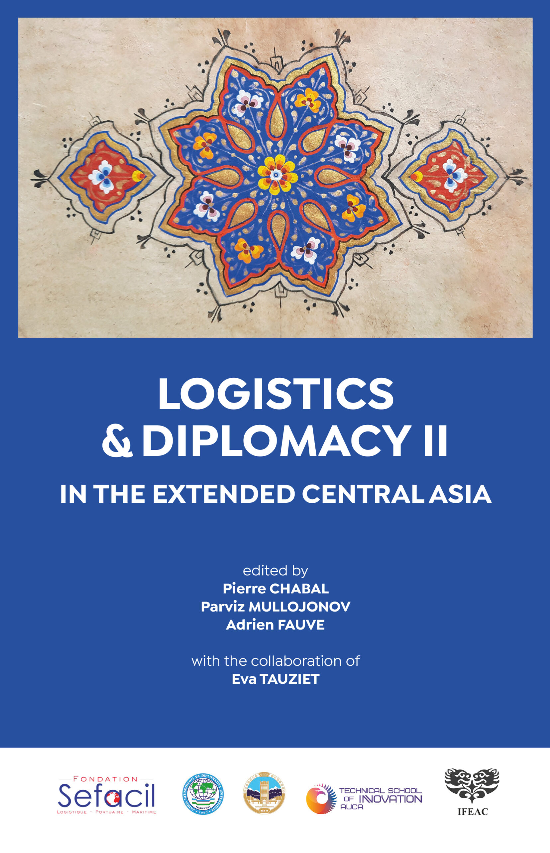
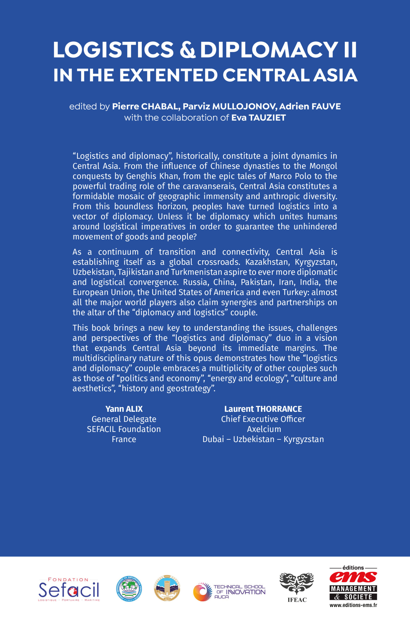
2021-2022: Co-organisations of 3 seminars:
October 2021 in Tashkent
November 2021 in Almaty
January 2022 in Bishkek

Slide 4
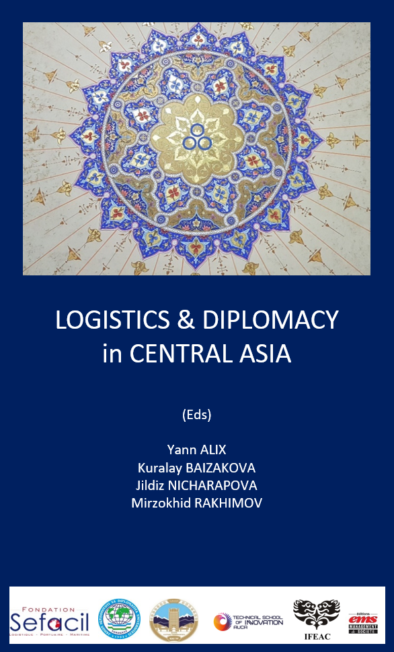
January 2022 – Book n° 1 Logistics and Diplomacy in Central Asia (Sefacil Foundation, EMS Edition) Chapter: “Opportunities linking South-and-Central Asia and Self-reliant India

Slide 5
2021-2022: co-participation in JNU University (New Delhi) on-line seminars on geopolitics coordinated by professor Archana Upadyhay, Chairperson of Centre for Russia and Central Asia Studies.
Mother Russia: State, Country and Patriotism in Russian History;
Post-Karabakh Conflict Equilibrium and Prospect for Regional Integration;
Exploring Eurasian Gateways: Russian Travellers in XIXth-Century Punjab;
‘Locating Armenia in the Contemporary Eurasian Geopolitical Space’, ect.

Slide 6
Joint Chapter in Book coordinated by Archana Upadhyay
The Eurasia Story: Past and the Present,
Chapter: “What Security the Western Eurasia after the Demise of the Warsaw Pact? Evolving Concepts and Security Strategies”. Forthcoming.

Slide 7
May 2022 : Conference: The Completion of Eurasia?
Chapter by Dr. Khodjaeva
“Cultural Diplomacy: Building Bridges between South Asia Central Asia Diplomacy”

Slide 8
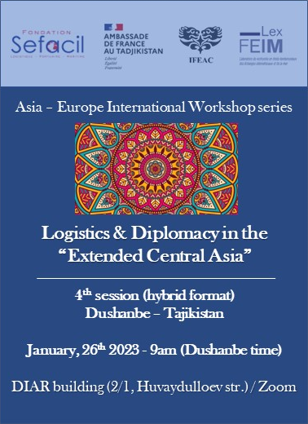
Co-organiser of Seminars: - January 2023, Dushanbe, Tajikistan; - October 2023, Almaty, Kazakhstan

Slide 9
Co-organiser of Jawaharlal Nehru University (QS top 600) New Delhi Seminar. February 2024 and October 2024.

Slide 10
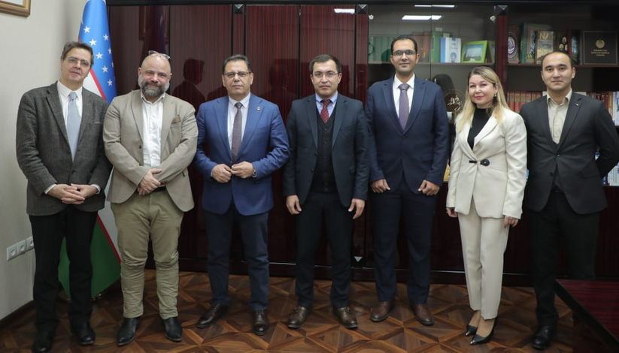
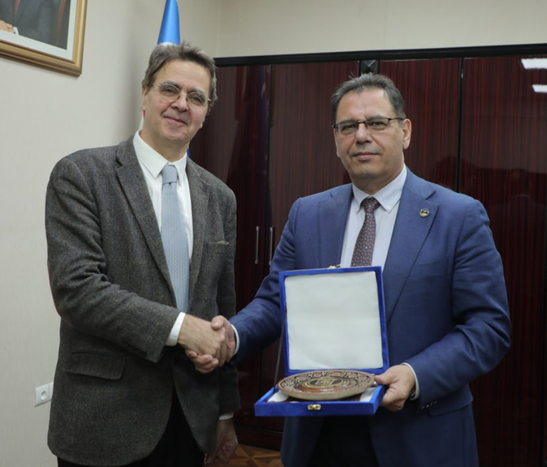
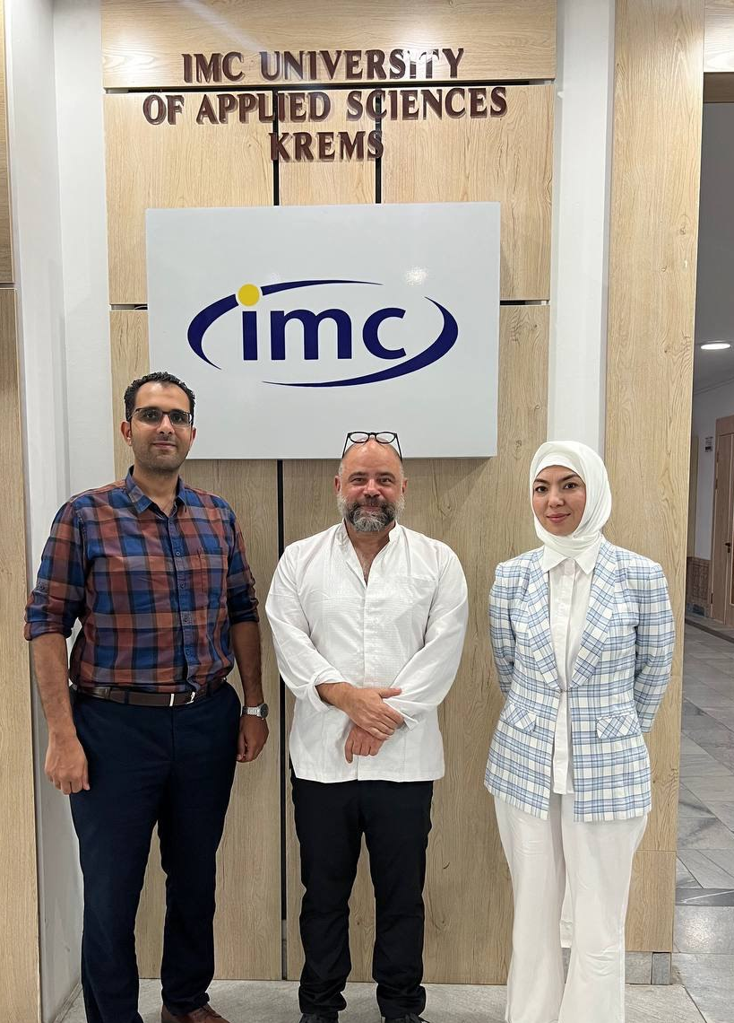
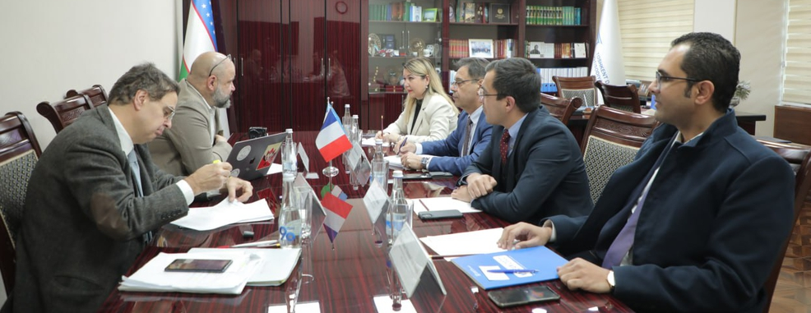
Co-ordination of delegations ULHN - TSUE: January, 2023; November, 2023; March, 2024

Slide 11
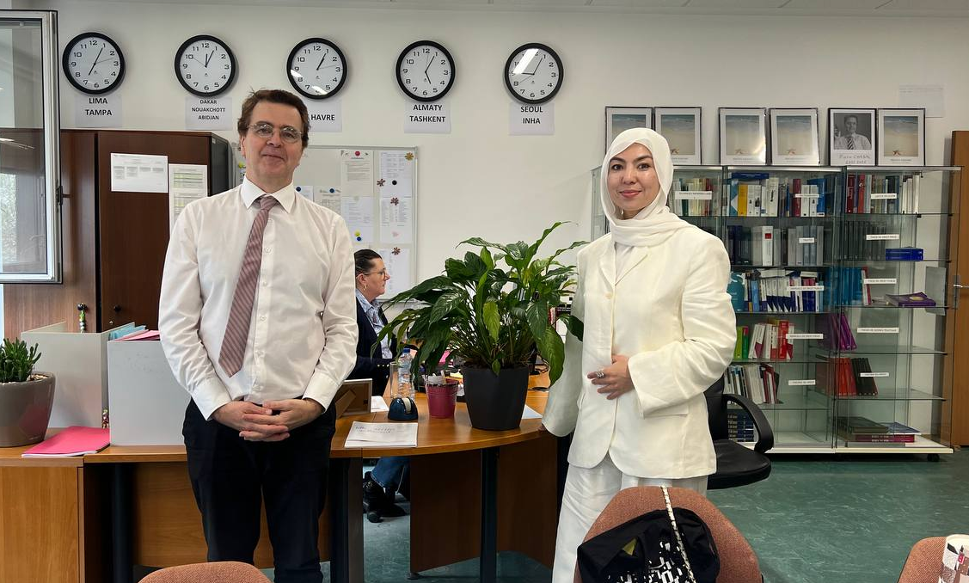
HERE WE ARE!

